Slide 1
Water Leakage Over Time (2017-2018)

Slide 2
Overview
Total residences: 14448
Total annual consumption (2017): 9,286,803,685 gallons
Average number of ongoing leaks per day: 7
Number of Days with more-than-avg. ongoing leaks: 2638
Most ongoing leaks in one day: 117 (1/3/2017)
Average total use per day: ~2.565 Million gallons
Highest use day: ~335.6 Million gallons (4/26/2017)
Number of days of above-average use: 29

Slide 3
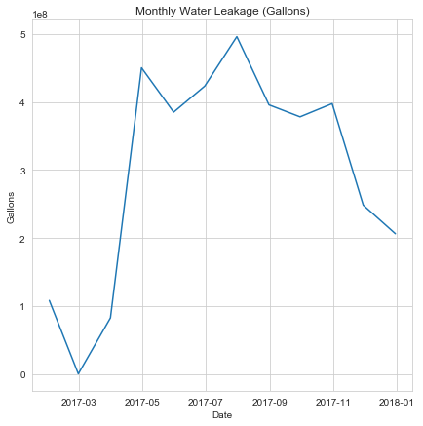
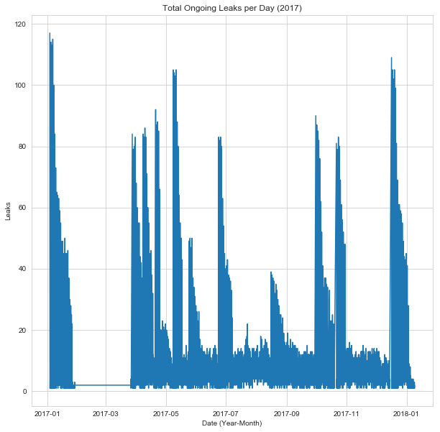
Water Leakage
10 Million gallon decrease in leaks (January - March 2017)
Extreme leakage increase at least once per month, increasing in frequency April - July
Consistent duration each time

Slide 4
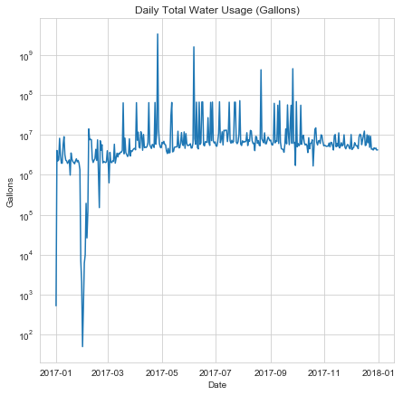
Water Usage
100x short usage spikes in late April, June, August, and late September
Several short 10x increases in June, July, September, and October
10,000x usage below average in late January - February for two weeks
First week of January ~10,000x below average usage

Slide 5
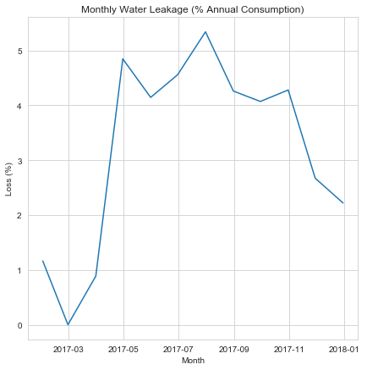
Water Lost in Leaks
Total Annual Consumption (2017):
9,286,803,685 gallons
% of annual consumption lost in leakage remains less than 6%
Average monthly % loss:
29.76 Million gallons
Most loss in May, July, October

Slide 6
Next Steps
Evaluate with temperature and precipitation data for service area
Consider late 2016 data to investigate abnormally low usage in Jan., Feb.
Use residence location information to observe relationship between location and leaks and usage
Predictive modeling:
Future usage
Leak rate

